Slide 1
Lecture # 1
Introduction to Ethics
Instructor
Dr. Shahnawaz Muhammad Khan

Slide 2
Content
Definition
Kinds
Moral values
Ethical terms
Absolutism vs. Relativism
Importance of ethics

Slide 3

Ethics
Ethos means characters and custom.
It is the study about right or wrong act.
What ought to be in general
How should people act or live ?
Search for ultimate goodness and right conduct.
Judge the action according to standards of Justice, humanity, truth, goodness are basics of action
What is the highest good or virtuous life.

Slide 4
Scope of Ethics
Ethics studies only actions of human beings
It is argued that actions of human beings who are not living in a society are excluded from the scope of ethics

Slide 5
The Three Branches of Ethics
Meta-ethics
Normative Ethics
Applied Ethics

Slide 6
Meta-ethics
Study of the meaning of ethical terms & concept which forms the foundation of morality
Examples:
- What is the meaning of (term) right?
- Is morality objective? Testable?

Slide 7
Normative Ethics
Study of what makes an action morally right/wrong or good/bad, what rule should one follow in order to a good person etc.
Examples:
-What should I do? What is right action to do?
-How should I live my life?

Slide 8
Applied Ethics
Application of moral principles and ethical theories to practical problem.
Examples:
- Do corporates have a responsibility towards environment?
- Is it wrong to donate your body organ to save other life?

Slide 9
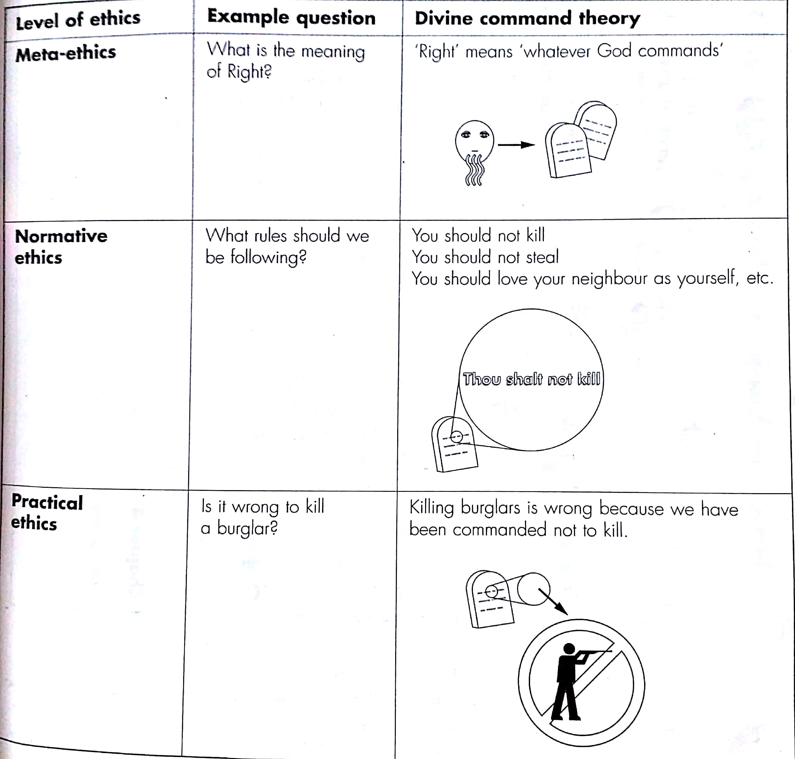
An overview of branches

Slide 10
Imagine your friend has just got ready for the farewell party ……..
…….she/he strikes a pose and says ‘How do I look like?’…….
You think: ‘Yuk!’

Slide 11
You have a problem…….
What is your problem?

Slide 12
What should I choose….. A moral dilemma
Honesty vs. Kindness
Video recourse: Moral Delimma
https://www.youtube.com/watch?v=KfF5N1MaIxA

Slide 13
Moral dilemma of this sort are common…..
….in which moral rules/ moral values come into conflict…

Slide 14
What should I do?
…..may appear insignificant but is one of the most important questions
“It is our whole way of life that is at issue” Socrates (469-399)

Slide 15
Not all uses of ‘should’, ‘ought’ and ‘good’ are moral uses:
The newspapers should double–check their facts before they write such headlines
It is good to have ice cream in a hot day
Should I take coffee or tea?
People of Karachi should smile more
Ahmed should have passed the ball earlier
Its bad to "customize” and submit a research paper as your own which you purchased online

Slide 16
What moral choice you make says much about :
The principles you have
The things that are important to you
The values you hold

Slide 17
Activity:
Step1:
List any ten moral values which you hold ( the things which are important to you)
For example some of the values are;
Family, Money, Education, Honesty etc.
Step2:
Prioritize the values you have listed

Slide 18
Activity Questions:
Do we have same top values?
Would your answer be same if asked 10 years back or will it be same after 10 years?
Where do these values come from?
Do the values affect your choices?
Case study

Slide 19
Moral Compass
“An Internalized set of values and principles that guide a person with regard to ethical behavior and decision making”

Slide 20
Ethics…..
primarily, but not only, deals with the question; What should I do?
……Implied in any choice is a value or value judgment ……
…In addition ethics deals with questions of values
What is right to do? & what is good to do?

Slide 21
Ethics
The study of values that govern our moral character and our relationship with other people
a branch of Philosophy which critically examines the moral beliefs and moral standards; studies what constitutes good and bad human actions

Slide 22
In broader terms, the questions that Ethics poses take many forms:
Do we have a moral responsibility toward less fortunate people?
Is it wrong to divulge a secret someone has confided in you?
Should we wear animal skins?
Should we try to keep people alive at all costs, no matter what their physical or mental condition?
Is it wrong to kill someone in self-defense?
Should people be given equal opportunities, regardless of race, religion, or gender?

Slide 23
Levels of Ethics:

Slide 24
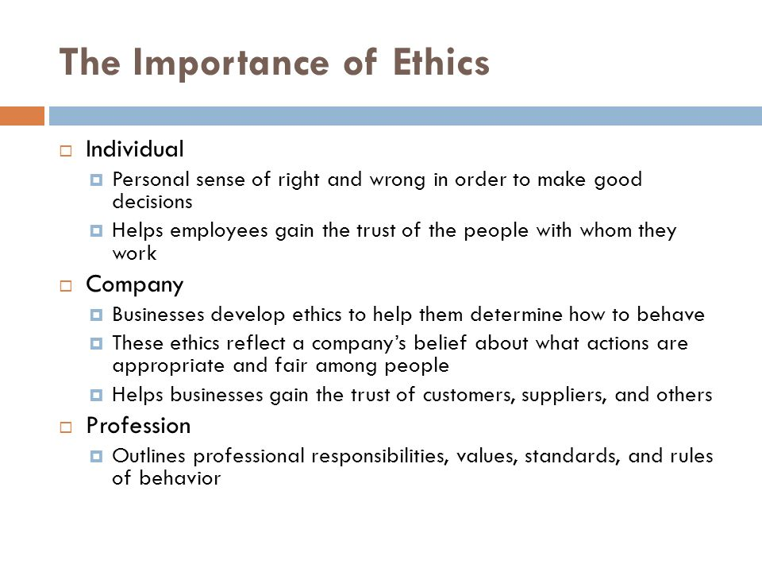

Slide 25
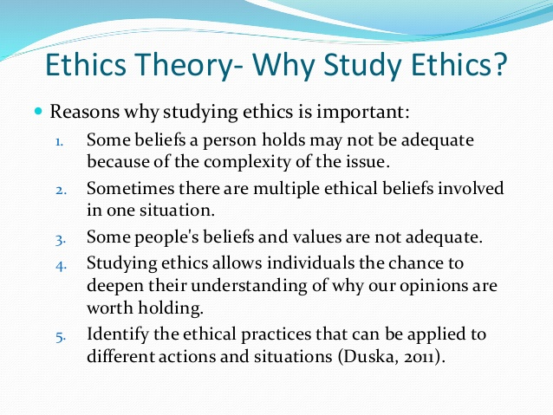

Slide 26
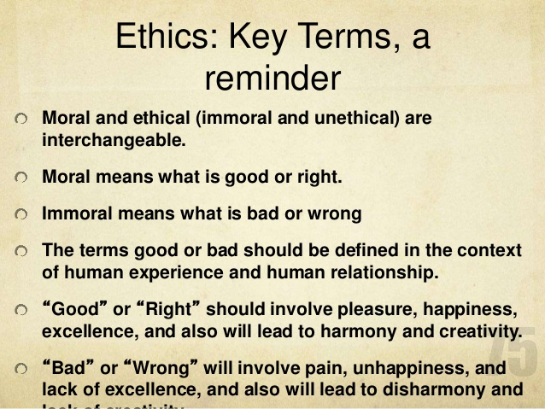
Terms

Slide 27
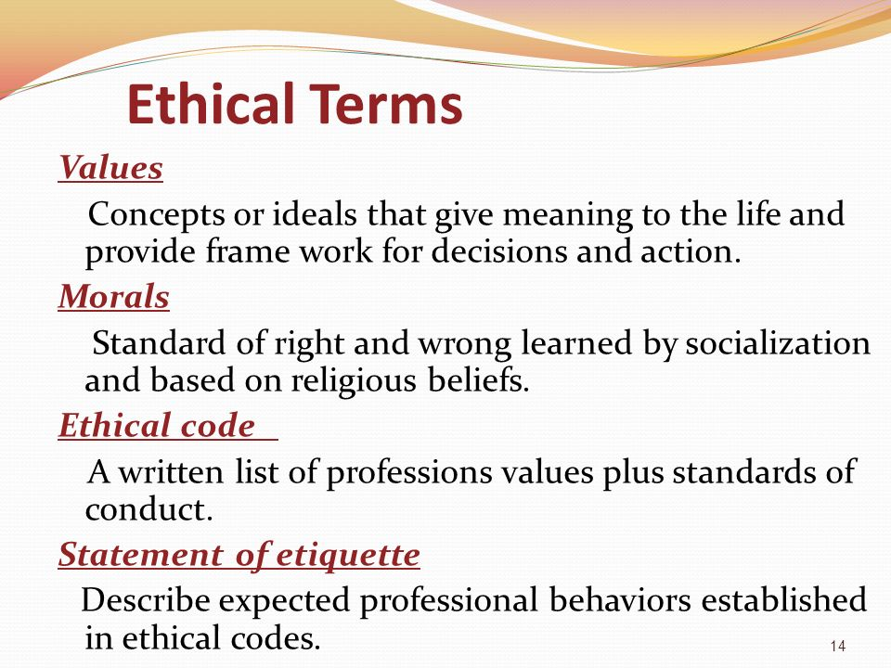
Terms

Slide 28

1.Relativism
Protagoras “Men is the measure of all things.
Everything is relative, depend on their perspectives.
Different societies have different idea of ethics.
There is no absolute right or wrong in the world.
It varies from place to place ,person to person.
Moral laws are based on custom and tradition.
Morality is relative so we should do respect others.
We cannot define and communicate ethical values.
Might is right, ethics is inherited in power game.
Where do you live, do as they do and do respect.

Slide 29
Absolutism
It is the absolute ,universal truth or highest goodness.
There is only one single more code apply to all
Something right or wrong are irrespective of time.
It includes objectives absolute rightness.
There is some foundational principles.
For e.g killing is always immoral even of for self defence.
Right maybe universal (life,liberty,happiness)
There are set of rules to follow in all situations.

